Slide 1

My GameUp Africa Journey
Esther O Epelle

Slide 2


About Me
Esther O Epelle
I’m a Game developer and data analyst in Nigeria, I specialize in game developing, app developing,front end development. I thrive on challenge and constantly set goals for myself, so I have something to strive toward. I’m not comfortable with settling, and I’m always looking for an opportunity to do better and achieve greatness.
Location: Lagos, Nigeria, Country Gender: Female
Interest: Baking, Gaming, Playing Chess, outing
Ambition
I’d like to become an expert in the field of game as it relates to this industry, and the prospect of working in this role would allow me to hone my skills.
*Your Picture
Esther O Epelle

Slide 3
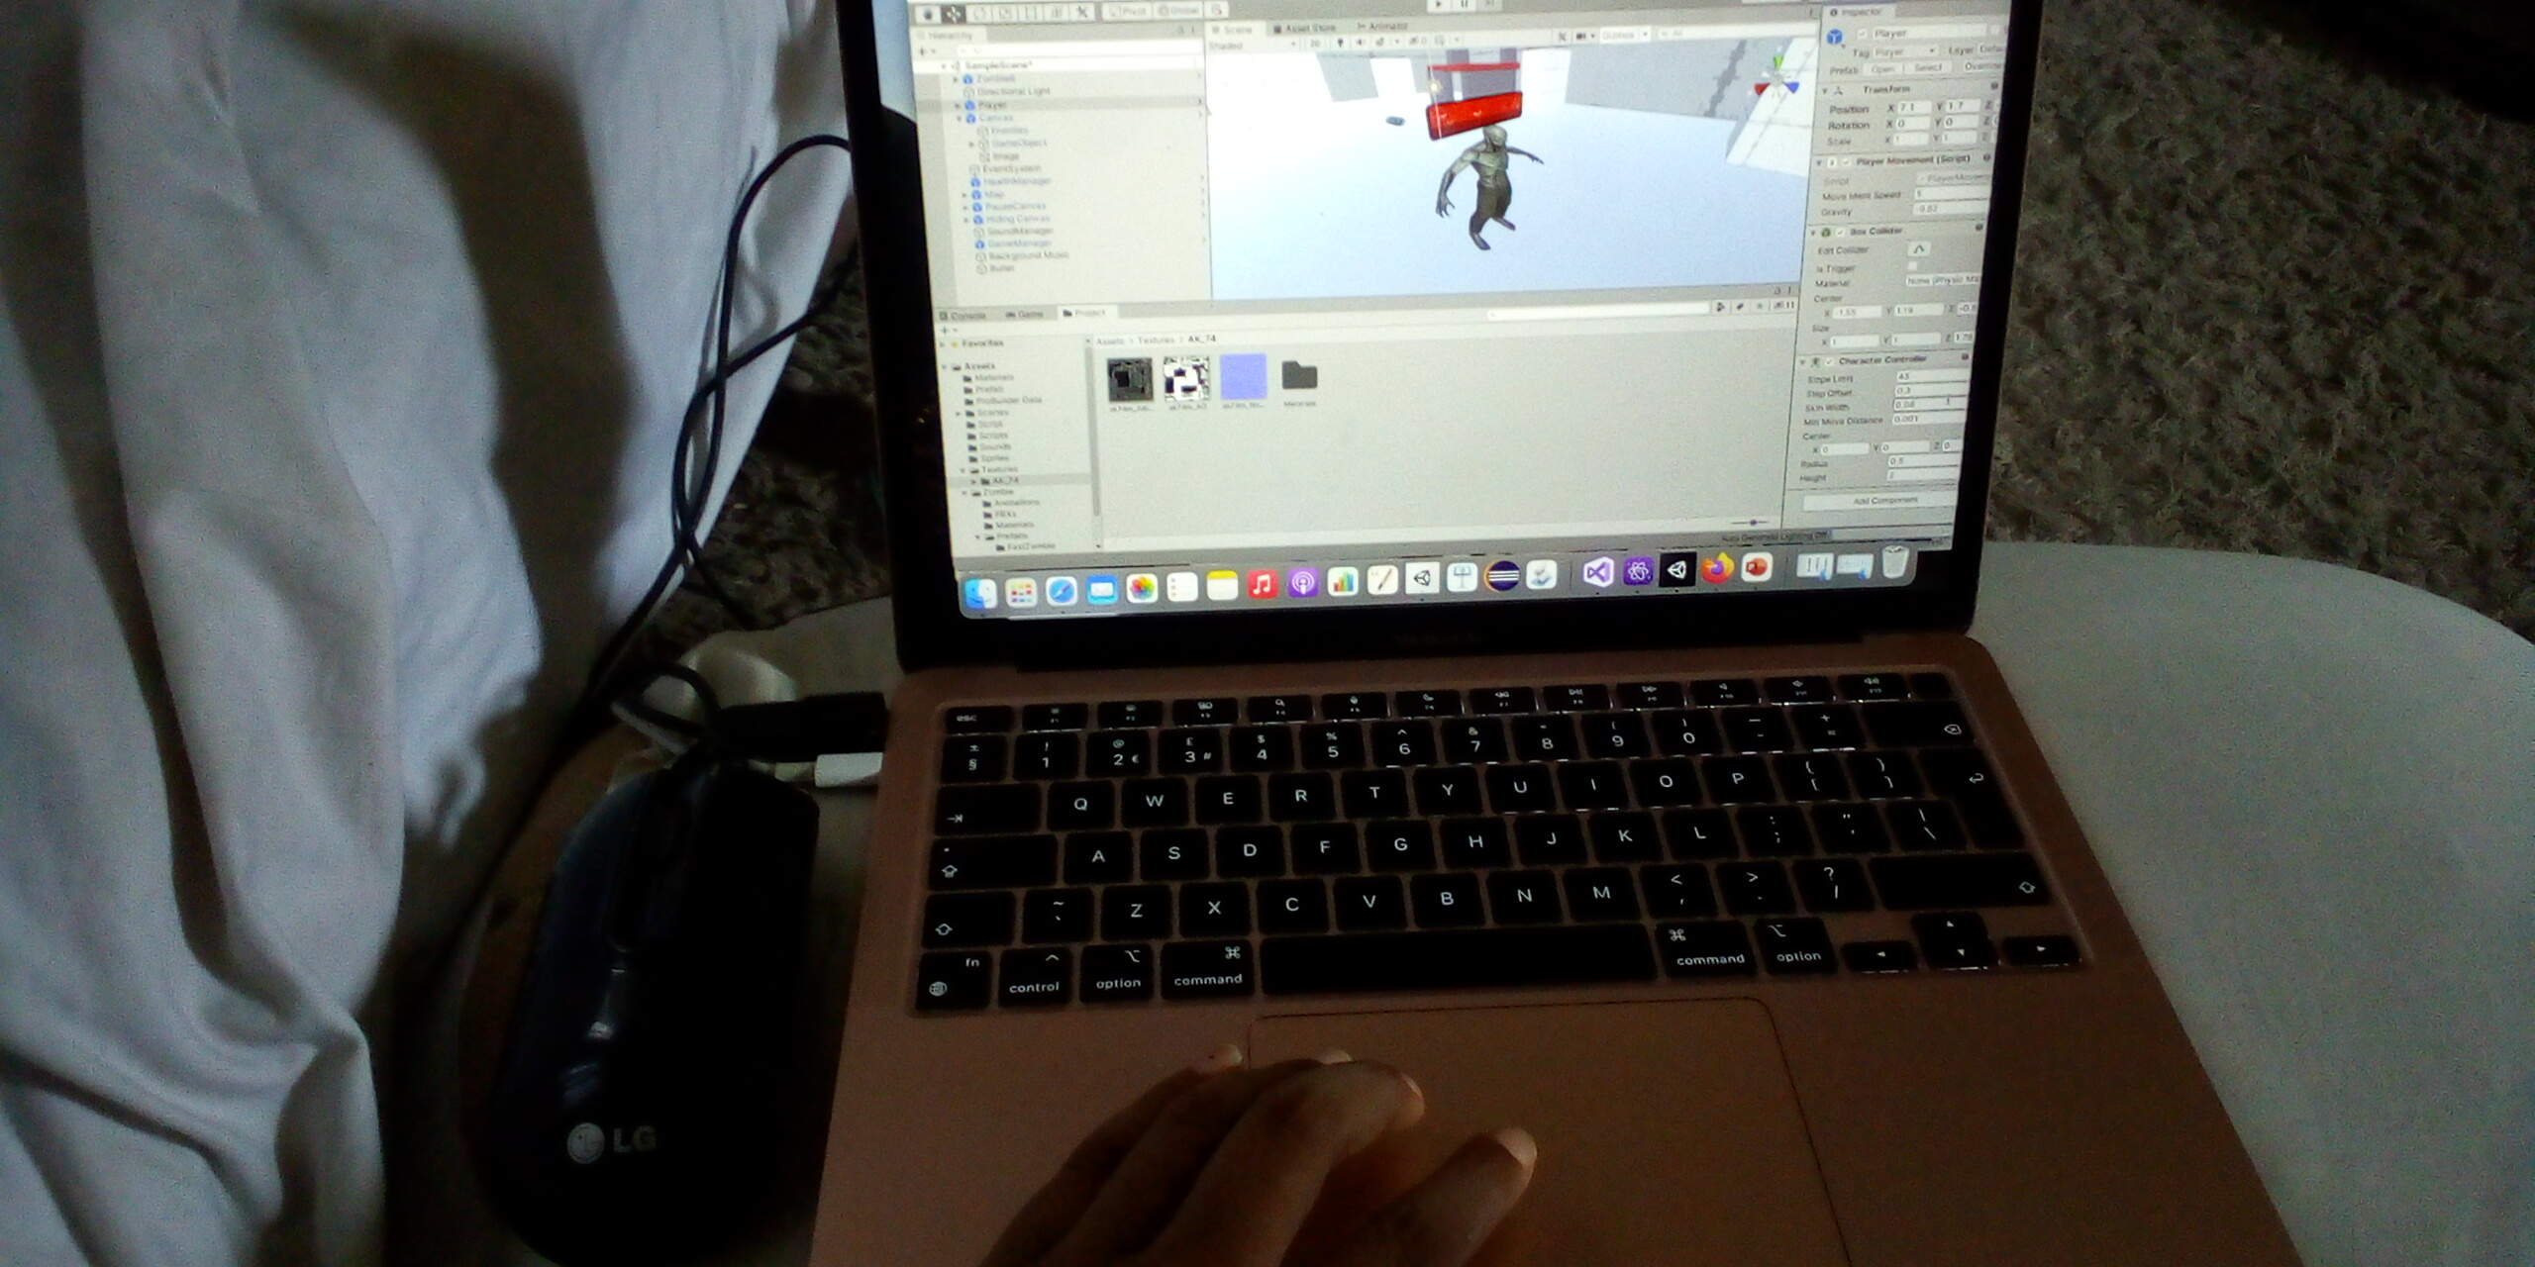
My Learning Experience
What you enjoyed
Learnt how to create games in 3D and how it allows for very fast iteration and can be extremely useful when brainstorming for a new game concept. Meeting various people from different background in the game industry.
What you learnt
Manage my time
Creating Game systems and mechanics
Some new discoveries along the way
Learnt how to create animation behaviour script
*Picture of yourself at your workstation
Esther O Epelle

Slide 4
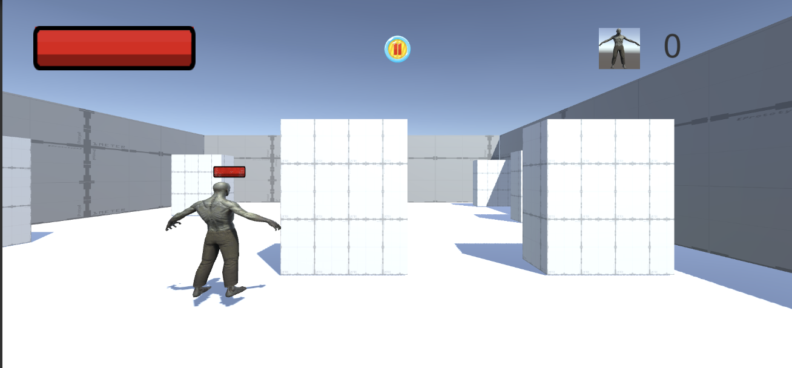
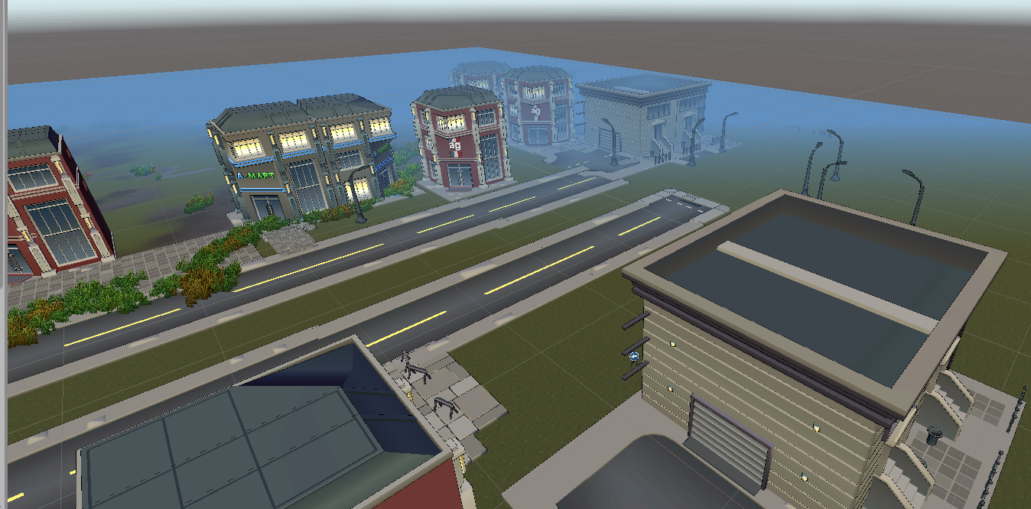
My Game Project
HalTown
It is a town FPS Game, to restore immersive atmosphere of classic FPS. It is an offline adventure which involves fighting game against mystic beasts, talking to individual in the game
It Will lead you on fighting quest in the jungle or a city
Target Audience
It is made for everyone to enjoy adventure on either a phone or tablet.
Genre
I want to build a adventure, fps(TPs),
Platform
Android, Mac
Your Name

Slide 5
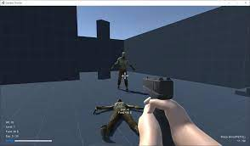
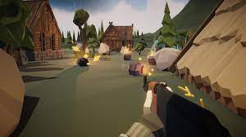
Gameplay Mechanics
The aim of the game is to improve your character over the course of the game by increasing his statistics or levels.
The ability to interact with elements of the environment or storyline through additional abilities
To kill a mystic creature and collect either gold or resources which is centered around a gun or a creature either in a town or a jungle
Search and destroy
May be have Last man Standing
Player Control
The game can be played using the control found on the game
Game Type
I am building a mid core action game
*Screenshots of your game or a similar game
Your Name

Slide 6


THANK YOU
@Esther90682956 @essyba

